Slide 1
Interaction with api

Slide 2
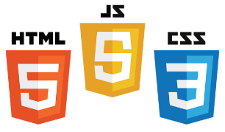
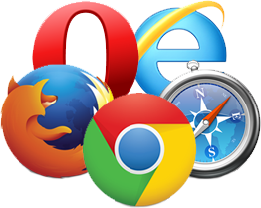
Web Applications
.
UI (Front End (DOM, Framework))
Request Layer (Web API)
Back End (Database, Logic)
Server
Client
API
Front End
Database
Browser
Internet
Logic
JSON
Media Cache
Notes:
Break down into front end and back end

Slide 3
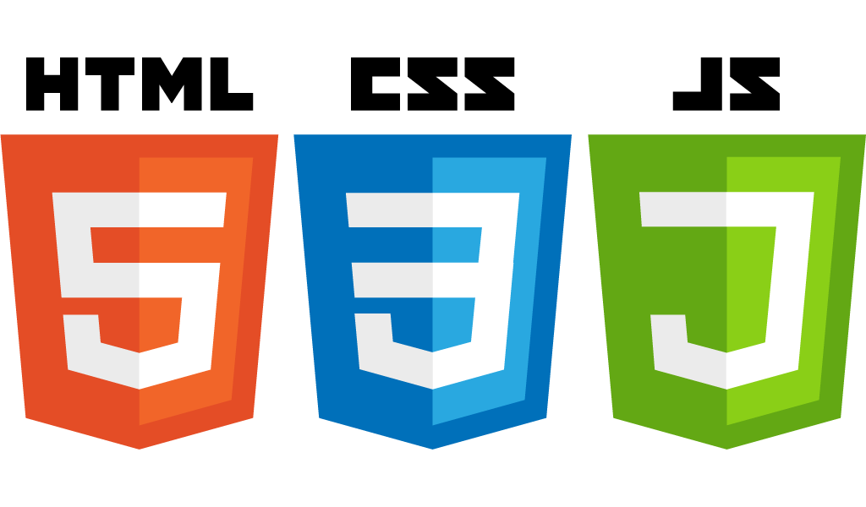
Frontend development

Slide 4
Front End Languages
HTML/CSS
Javascript
Java (applets)
Notes:
Javascript adoption with ES6, ‘don’t forget about babel’
Node.js:
Swift 2: Apples vision for modern web programming
Go: growing in popularity with startups
TypeScript: Beauty of statically type Javascript (PS: Microsoft Technology)

Slide 5

DOM (Document Object Model)
Document Object Model menjadikan setiap item yang dialamatkan dalam aplikasi web dapat dimanipulasi untuk warna, transparansi, posisi,suara
Setiap HTML Tag adalah sebuah DOM object

Slide 6
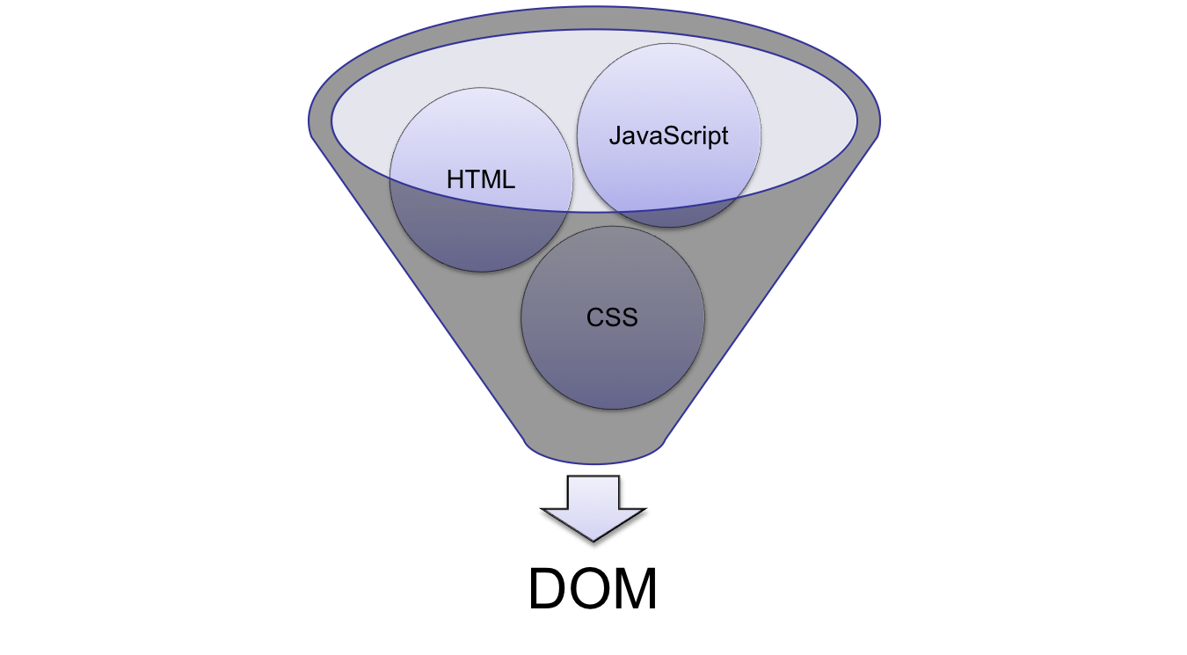
DOM (Document Object Model)
Notes:
HTML: Creates the DOM
CSS: Decorates the DOM
JavaScript: Modifies the DOM Dynamically
Back End Language: (PHP, Python, Ruby, F#): Generates the DOM on the fly

Slide 7
What is a Framework?
Types of Framework Architectures
Model-View-Controller (MVC)
Three Tier Organization
Client (Usually the browser running HTML/Javascipt/CSS)
Application (Running the Business Logic)
Database (Data Storage)
Types of Frameworks
Server Side: Django, Ruby on Rails
Client Side: Angular, React, Vue
Notes:
MVC: separated (data model, logic, user interface)
Push-based frameworks use actions that do the required processing, and then "push" the data to the view layer to render the results
component-based: These frameworks start with the view layer, which can then "pull" results from multiple controllers as needed.

Slide 8
Framework
Framework
Notes:
HTML: Creates the DOM
CSS: Decorates the DOM
JavaScript: Modifies the DOM Dynamically
Back End Language: (PHP, Python, Ruby, F#): Generates the DOM on the fly

Slide 9
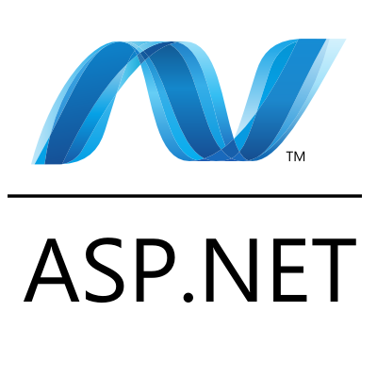

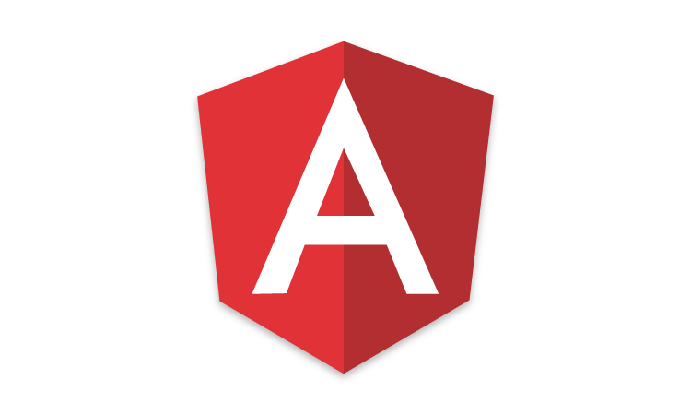

Javascript Frameworks
http://hotframeworks.com
AngularJS/Angular 2
ASP.net
React
Polymer 1.0
Ember.js
Vue.js

Slide 10
MVC (Model View Controller)
A Web Application Development Framework
Model (M):
Where the data for the DOM is stored and handled)
This is where the backend connects
View (V):
Think of this like a Page which is a single DOM
Where changes to the page are rendered and displayed
Control (C):
This handles user input and interactions
Buttons
Forms
General Interface

Slide 11
BACKEND development

Slide 12
What is a Backend?
Semua yang berjalan pada aplikasi
Web API
Terhubung antara layer frontend dan backend
Terhubung dengan API calls (POST, GET, PUT, etc. )
Mengirimkan data pada Backend ke Frontend dengan JSON

Slide 13
What is a WebAPI?
Layer antara front end dan back-end system
A “must have” if your APIs will be consumed by third-party services
Keterangan
Bagaimana API berjalan (signature, content negotiation)?
Standar yang digunakan (response codes, etc.)?
Apakah aman?

Slide 14
Representational State Transfer (REST)
Client-server
Stateless
Resource-based (vs. remote procedure call)
HTTP methods (GET, POST, PUT, DELETE)
Side Effects
It’s a style, not a standard

Slide 15
WebAPI Terms
GET – “read”
POST – “insert” (collection)
PUT – “replace”
DELETE – “remove”
PATCH – “update”
Custom (proceed with caution)

Slide 16
COnt
API menyediakan interaksi antara software dengan laiinya tetapi bukan user
RapidAPI adlaah sebuah platform untuk akses web-based APIs.
web API yang terkenal adalah Representational state transfer API or RESTful API for short.
GET: Digunakan untuk request data dari endpoint
POST: Mengirim data ke an endpoint
DELETE: MEnghapus data dari sebuah endpoint.
PATCH: MengUpdate sebuah rekaman pada sebuah endpoint.

Slide 17
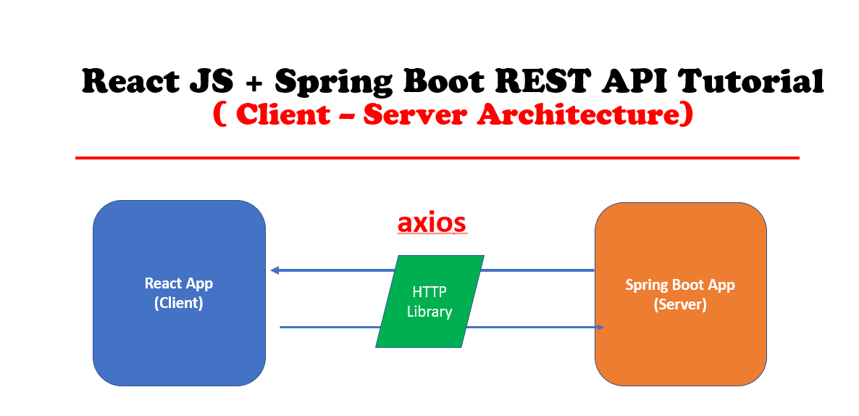
React JS + Rest api

Slide 18
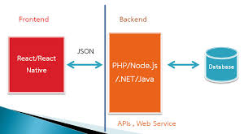
Cara kerja frontend dan backend

Slide 19
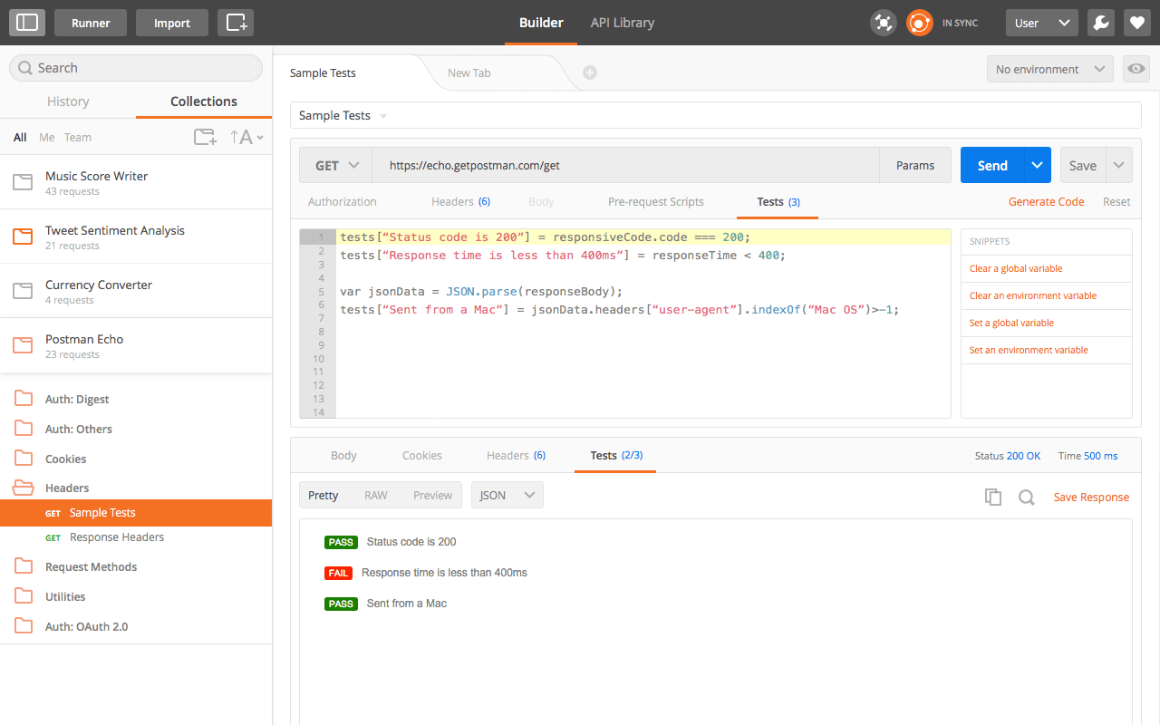
Tools for Testing WebAPI
Postman Chrome extension
http://bit.ly/postmanext
Fiddler by Telerik
http://www.Telerik.com/fiddler

